Slide 1
Topic: Measurement
EQ: How do I convert between volume and capacity units?
Get your VIVO’s
Topic and EQ in Interactive Notebook
NO PHONES OR EAR BUDS
- Keep working on completing the formula card and example card in preparation for the test
Notes:
Explaining this slide: Demonstrate the “type of response”: In 2 minutes (timed), you are going to share with your shoulder partner all of the formulas and examples you have written. You will get 2 mins (timed) to write down any formula/examples that your partners has that you haven’t and vice-versa. You and your partner then need to be prepared to share one formula and example on the board ( only choose 3 )
After marking the roll:
- Use active scanning and intervene if they are not. Use Private dialogue if needed

Slide 2
Learning Intentions
Students will be able to
calculate the volume and capacity of cubes, rectangular and triangular prisms and cylinders.

Slide 3
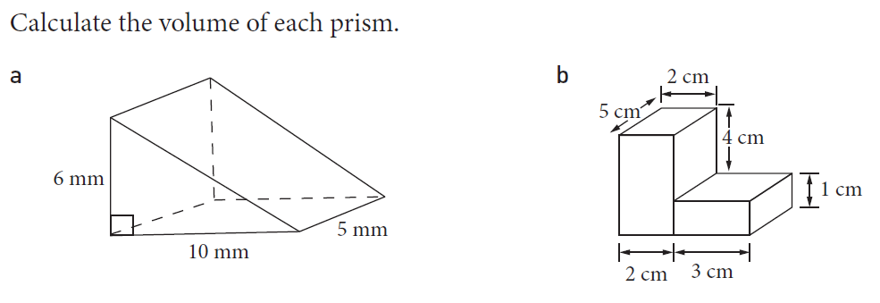
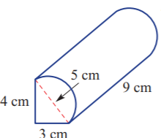
From Last Lesson

Slide 4
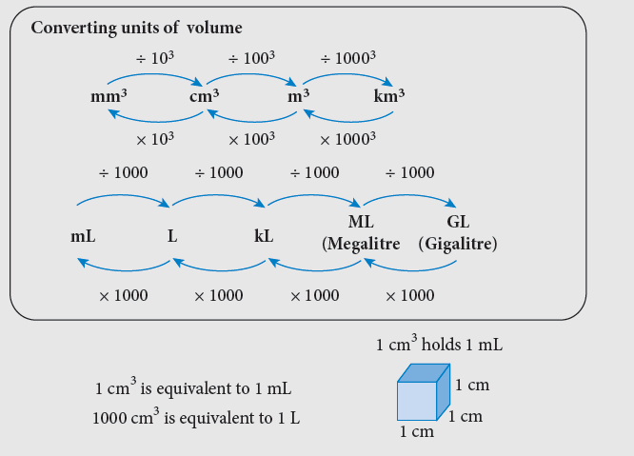
24
7
30
Measurement
Date
EQ – How do I convert between volume and capacity units?
Remember from the first volume lesson

Slide 5
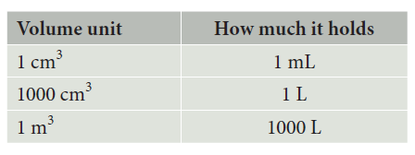
24
7
30
Measurement
Date
EQ – How do I convert between volume and capacity units?
Remember from the first volume lesson

Slide 6
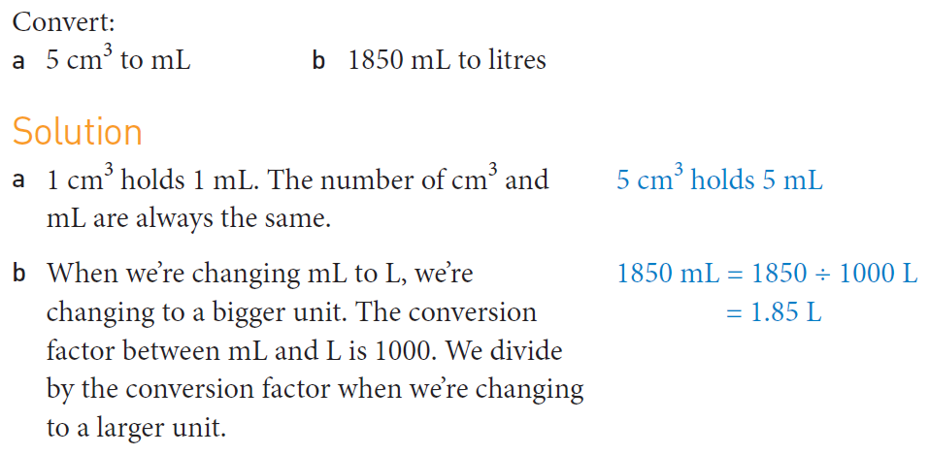
Practice

Slide 7
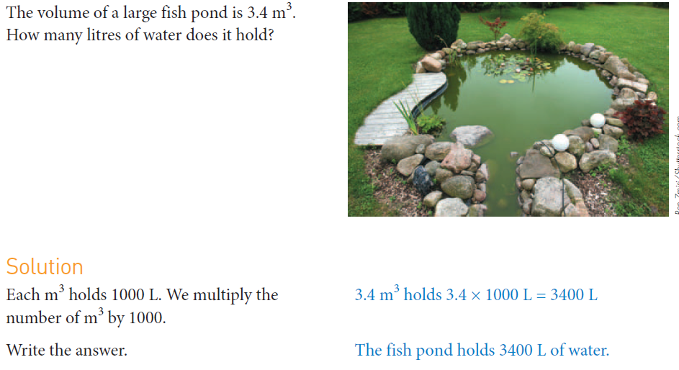

Slide 8
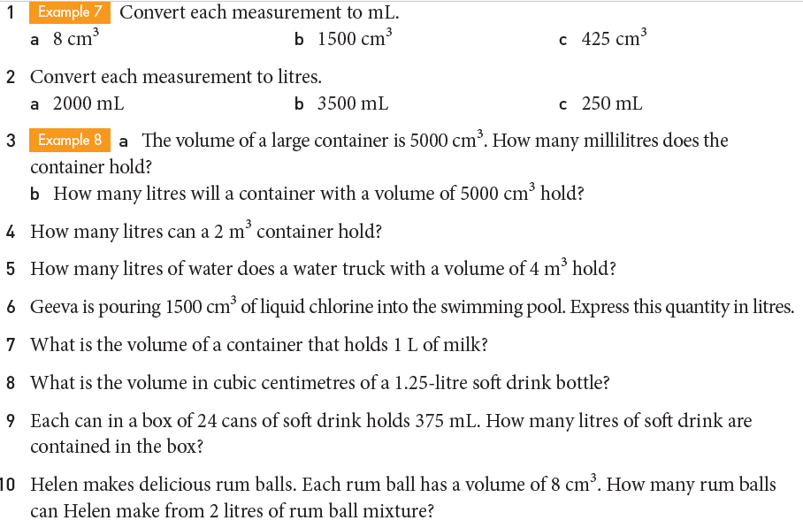
Task

Slide 9
